Slide 1

GAME PROGRAMMING
Week 7 — C# Fundamentals & Unity Tilemaps
{
}
Lecture 14 & 15 | Game Programming Course

Slide 2
TABLE OF CONTENTS
Today's Agenda
01
Lecture 14 — C# Programming Fundamentals
Variables, Conditionals, Loops, Functions, Classes & Unity Integration
02
Lecture 15 — Unity Tilemap System
Tile Palette, Rule Tiles & Animated Tiles
Game Programming | Week 7

Slide 3
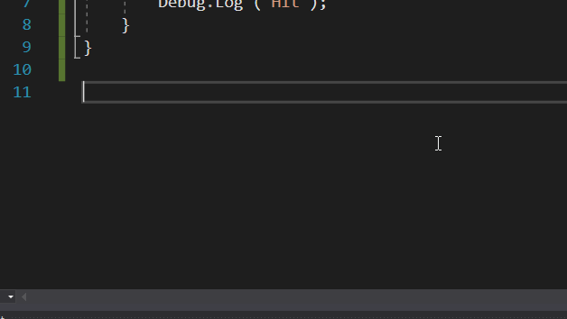
14
LECTURE 14
C# PROGRAMMING
FUNDAMENTALS
Variables, Control Flow, Functions, Classes
& Unity Integration

Slide 4
C# Variables — Storing Data in Your Programs
Variables are named containers that store data values in memory. C# is a strongly-typed language — every variable must have a declared type.
Common Built-in Types
Type | Description | Example
int | Whole numbers | 42, -7, 0
float | Decimal numbers | 3.14f, -0.5f
double | High-precision | 3.14159265
bool | True / False | true, false
string | Text sequence | "Hello"
// Variable declaration syntax
int score = 0; // whole numbers
float speed = 5.5f; // decimal (suffix 'f')
bool isAlive = true; // true or false
string name = "Player"; // text sequence
Variable Scope & Constants
Scope determines where a variable can be accessed — local variables exist within their enclosing braces {}, while class-level fields are accessible throughout the class.
Constants (declared with const) cannot be modified after initialization.
Unity Tip
Use [SerializeField] to expose private variables in the Unity Inspector.
04

Slide 5
Variable Types & Type Conversion
Value Types
Reference Types
Store data directly on the stack.
Types: int, float, bool, struct
Unity: Vector2, Vector3, Quaternion are structs.
Store a memory reference on the stack pointing to heap data.
Types: string, class, array
Objects created with new are reference types.
Type Conversion
Type Inference with var
// Implicit conversion (no data loss)
int i = 10; float f = i; // 10.0f auto
// Explicit casting (possible data loss)
float f2 = 3.7f; int x = (int)f2; // x = 3
The var keyword lets the compiler infer the type:
var health = 100; // compiler infers int
05

Slide 6
Conditionals — Making Decisions in Code
Conditional statements execute different code blocks based on boolean expressions.
Comparison & Logical Operators
Operator | Name | Example
== | Equal to | a == b
!=, <, > | Not equal, etc. | a != b, a > b
&& | AND | a > 0 && b < 10
||, ! | OR, NOT | a || b, !active
// if-else if-else chain
if (score > 100) {
levelUp = true;
} else if (score > 50) {
bonus = 10;
} else { gameOver = true; }
// switch — ideal for state machines
switch (gameState) {
case "Menu": ShowMenu(); break;
case "Play": UpdateGame(); break;
case "Pause": ShowPause(); break;
default: break; }
Ternary Operator — compact conditional:
result = condition ? valueIfTrue : valueIfFalse;
Short-circuit: && and || stop evaluating once the result is determined.
06

Slide 7
Loops — Repeating Code Efficiently
Loops execute code blocks repeatedly. Choose the right loop for your use case.
for loop
while loop
Best for known iteration counts.
for (int i = 0; i < 10; i++) { spawnEnemy(); }
Continues while condition is true.
while (health > 0) { ProcessCombat(); }
foreach loop
do-while loop
Iterates over collections without index management.
foreach (var enemy in enemies) { enemy.Move(); }
Guarantees at least one execution.
do { ShowPrompt(); } while (!validInput);
Loop Control Keywords
Unity uses loops for:
Spawning enemies, processing GameObject arrays, animation sequences, and batch operations.
break — exits the loop immediately
continue — skips to the next iteration
07

Slide 8
Functions — Organizing Code into Reusable Blocks
Functions encapsulate reusable code blocks.
Method Overloading
Multiple methods with the same name but different params:
void Damage(int amt);
void Damage(int amt, bool c);
// Method declaration
returnType Name(params) {
// body
return value; }
// Examples
void Jump() { vel.y = jumpForce; }
int Add(int a, int b) { return a+b; }
Recursion
Functions that call themselves — useful for tree traversal and procedural generation.
Parameter Passing
Best Practices
By value — a copy is passed (default)
ref — passes the actual variable reference
out — output parameter, must be assigned
void Heal(ref int hp) { hp += 10; }
Single responsibility — one task per function
Meaningful naming — verb-based: CalculateDamage()
Keep short — under 20-30 lines for readability
08

Slide 9
Classes — Object-Oriented Programming in C#
Classes are blueprints for creating objects, combining data (fields/properties) and behavior (methods).
Core OOP Principles
Encapsulation
Inheritance
Polymorphism
Hide state with private. Expose via properties with getters/setters.
Derive from base classes to reuse and extend:
class Enemy : Character { }
Override base class methods in derived classes for specialized behavior at runtime.
Class Example: Player
public class Player : MonoBehaviour {
[SerializeField] private int hp = 100;
public int HP { get; private set; }
public void TakeDmg(int d) { HP -= d; }
}
Static Members
Belong to the class itself, not instances. Shared across all objects.
Namespaces
Organize related classes and prevent naming conflicts: using UnityEngine;
09

Slide 10
C# within Unity — MonoBehaviour Lifecycle
Unity scripts inherit from MonoBehaviour, gaining access to the engine's callback system.
Awake()
Start()
Update()
LateUpdate()
OnDestroy()
← loops every frame →
Lifecycle Methods Explained
Awake()
Start()
Update()
Called once when script loads. Init references.
Called before first frame. Game logic init.
Called every frame. Input and game logic.
FixedUpdate()
LateUpdate()
Coroutines
Fixed intervals. Physics code (Rigidbody).
After all Updates. Camera, post-processing.
Time-delayed ops via yield return.
Execution Order: Awake → Start → (FixedUpdate / Update / LateUpdate loop) → OnDestroy. Use [DefaultExecutionOrder] attribute to customize script execution priority.
10

Slide 11
Unity Scripting — GameObject & Component Model
Unity uses GameObjects (entities) and Components (modules).
Input Handling
Accessing Components
Input.GetAxis("Horizontal") — analog input (-1 to 1)
Input.GetKeyDown(KeyCode.Space) — key press
Input.GetMouseButton(0) — left mouse
Input.GetButtonDown("Fire1") — mapped button
// Get component on same GameObject
var rb = GetComponent<Rigidbody2D>();
// Search in children
GetComponentInChildren<SpriteRenderer>();
// Find in scene
FindObjectOfType<Player>();
[SerializeField] Attribute
Exposes private fields in the Inspector for designer-friendly tuning without breaking encapsulation.
Transform & Object Management
Transform — position, rotation, scale:
transform.position += Vector3.right * speed;
Instantiate() — create copies
Destroy() — remove objects
11

Slide 12
Programming Patterns in Unity
Common design patterns that solve recurring problems in Unity game development.
Singleton Pattern
Observer Pattern
Object Pooling
Ensures only one instance of a manager exists globally.
Use for: GameManager, AudioManager.
public static GameManager Instance;
Use C# events and delegates for loose coupling between systems.
public event Action OnHealthChanged;
Subscribers react without direct references.
Reuse GameObjects instead of Instantiate/Destroy to prevent GC stutter.
Critical for: projectiles, enemies.
Pre-allocate, activate/deactivate.
State Machine Pattern
Component-Based Design
Manage game states (Menu, Playing, Paused, GameOver) with switch or state classes. Each state has its own behavior.
enum GameState { Menu, Playing, Paused, GameOver }
Prefer composition over inheritance. Build entities by combining small, focused components. A "Player" is a Rigidbody2D + SpriteRenderer + PlayerController + HealthSystem — not a deep inheritance chain.
12

Slide 13
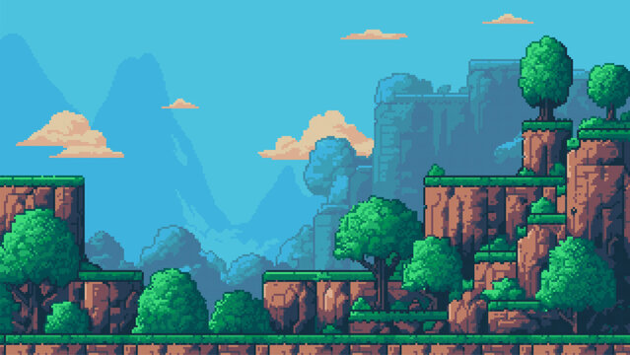
15
LECTURE 15
UNITY TILEMAP SYSTEM
Tile Palette, Rule Tiles & Animated Tiles
for Efficient 2D Level Design

Slide 14
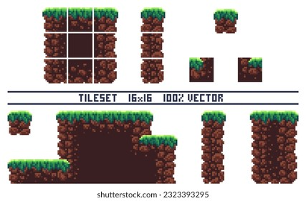
Introduction to Unity Tilemaps
The Tilemap system provides an efficient 2D level design workflow. Tilemaps are grids where each cell contains a Tile.
Key Benefits
● Rapid level prototyping and iteration
● Memory-efficient rendering (batched draw calls)
● Runtime tile manipulation for dynamic worlds
● Built-in collision via TilemapCollider2D
Core Components
Multiple Tilemap layers can be stacked on a single Grid for parallax backgrounds, foreground details, and collision separation.
Grid
Tilemap
Tile
Layout structure
Data layer on Grid
Visual asset
14

Slide 15
Setting Up the Tile Palette
The Tile Palette window is the primary tool for painting tiles onto Tilemaps.
1
Create a Grid via GameObject → 2D Object → Tilemap
Brush Tools
2
Open Window → 2D → Tile Palette
Tool | Function
Paint | Single tile placement
Box Fill | Rectangular area fill
Pick | Sample existing tiles
Erase | Remove tiles
Flood Fill | Fill contiguous regions
3
Create a new Palette asset (New → name → save)
4
Drag sprites into the Palette — auto-generates Tiles
5
Select a Tilemap target layer and brush tool
6
Paint directly in the Scene view
Tip: Slice sprite sheets in the Sprite Editor first (Grid by Cell Size) for organized tile sets.
15

Slide 16
Tile Assets & Brush Tools
Tile assets define what appears in each grid cell.
Tile Types Overview
Default Tile — displays a single sprite. The simplest tile type.
Tile Properties
Property | Description
Sprite | The visual image displayed
Color | Tint applied to the sprite
Collider Type | None, Sprite, or Grid collision
Custom Script | Inherit from TileBase for logic
Rule Tile — auto-selects sprites based on neighbors. Smart auto-tiling.
Animated Tile — cycles through sprites for dynamic effects.
Requires 2D Tilemap Extras package: Window → Package Manager → Unity Registry → 2D Tilemap Extras
Keyboard Shortcuts
[ ] Rotate brush | - = Flip H/V
Shift + Paint Temporarily switches to Erase
Active Tilemap Dropdown switches between layers
16

Slide 17
Working with Multiple Tilemap Layers
Professional level design uses multiple Tilemap layers for organization and functionality separation.
Background Layer
Ground Layer
Decoration Layer
Distant scenery, parallax — lowest sorting order
Walkable surfaces — primary collision layer
Visual details without collision — grass, flowers
Foreground Layer
Collision Layer
Elements in front of player — fences, tree tops
Invisible collision markers
Rendering & Collision Setup
// Layer hierarchy (bottom to top)
Background Order: -10
Ground Order: 0
Decoration Order: 5
Foreground Order: 10
// Ground: TilemapCollider2D + Composite
Each Tilemap has a Tilemap Renderer with Sorting Layer and Order in Layer.
TilemapCollider2D generates collision from tiles.
Use CompositeCollider2D for merged boundaries.
17

Slide 18
Rule Tiles — Smart Auto-Tiling
Rule Tiles auto-select sprites based on neighboring tiles.
Rule Evaluation
Rules are evaluated top-to-bottom. The first matching rule wins and determines the sprite.
Place specific patterns above general ones for correct behavior.
Installation
Window → Package Manager → Unity Registry → 2D Tilemap Extras
Create: Assets → Create → Tiles → Rule Tile
Neighbor Grid (3×3)
How It Works
NW
N
NE
Legend:
■ The tile being evaluated
■ Adjacent (N,S,E,W)
■ Diagonal (NE,NW,SE,SW)
Each position can be:
This / Not This / Don't Care
Each Rule Tile has Tiling Rules:
● Specifies a sprite
● Sets neighbor conditions
● Defines output mode
W
SELF
E
SW
S
SE
18

Slide 19
Configuring Tiling Rules
Tiling Rules define when each sprite variant appears based on neighbor conditions.
Neighbor Conditions
Output Modes
Symbol | Meaning | Requirement
■ This | Neighbor must be same tile | Same Rule Tile
□ Not This | Neighbor must be different | Different or empty
X Don't Care | Any state accepted | No check performed
Single — one sprite per rule. The standard mode for terrain edges and corners.
Random — randomly selects from a sprite list. Great for natural variety in grass or ground.
Common Rule Patterns
Animation — cycles through sprites for dynamic effects like flowing water or flickering lights.
Center Fill
All neighbors are This
■■■
■□■ ■■■
Edge Piece
Specific side is Not This
■■■
□□□ ■■■
Priority matters! Place specific patterns (corners) above general ones (center fills) in the rule list.
Corner Piece
Diagonal is Not This
■□■
■■■ ■■■
Isolated
All neighbors are Not This
□□□
□□□ □□□
19

Slide 20
Advanced Rule Tile Techniques
Extending Rule Tiles for complex scenarios and professional workflows.
Custom Rule Tiles
Multiple Biome Sets
Layered Rule Tiles
Inherit from RuleTile<T> to add custom properties like biome types or damage values that affect rule evaluation at runtime.
Create separate Rule Tiles for different biomes (grass, desert, snow). Swap them at runtime or assign per-level for visual variety.
Combine Rule Tiles on different Tilemap layers — one layer handles base terrain, another handles auto-placed decorations based on terrain rules.
Debugging & Performance
// Runtime tile manipulation
var tm = GetComponent<Tilemap>();
var p = new Vector3Int(x, y, 0);
tm.SetTile(p, tile);
var t = tm.GetTile(p);
Debugging: Use Scene view's Tilemap grid overlay to see active rules.
Performance: Rules evaluate at edit time — minimal cost.
20

Slide 21
Animated Tiles — Adding Life to Your Tilemaps
Animated Tiles bring tilemaps to life by cycling through sprites.
Setup & Configuration
Animation Sync & Variety
Create via Create → Tiles → Animated Tile.
● Ordered list of animation sprites
● Min/max animation speed (FPS)
● Start time for staggered anims
By default, animation is synchronized per-tile-instance.
For organic variation, use:
● Random start times
● Varied speed ranges (min/max FPS)
Common Use Cases
Pro Tip: Animated Tiles work on any Tilemap layer and can be combined with Rule Tiles using the Animation output mode for smart animated terrain!
Flowing Water
Flickering Torches
Swaying Grass
Pulsing Crystals
Conveyor Belts
21

Slide 22
Tilemap Performance & Best Practices
Optimizing Tilemap-based games for smooth performance across all target platforms.
Draw Call Batching
Chunk Size
Collision Optimization
Unity auto-batches tiles sharing the same sprite and material. Minimize unique sprites.
The Tilemap Renderer splits tiles into chunks for culling. Default (32×32) works for most games.
Use TilemapCollider2D + CompositeCollider2D + Rigidbody2D (static) for merged colliders.
Layer & Memory Optimization
Runtime Manipulation
● Avoid excessive layers
● Merge decorative layers
● Large maps use more memory
● Use chunk-based loading
// Procedural generation
tilemap.SetTile(pos, tile);
// Destructible terrain
tilemap.SetTile(pos, null);
// Check at position
var t = tilemap.GetTile(pos);
22

Slide 23
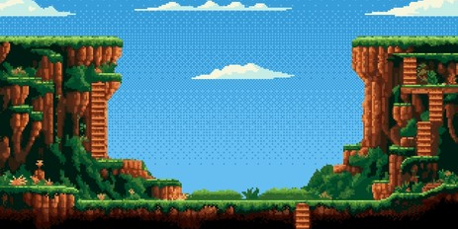
Putting It All Together — Level Design Workflow
A complete workflow for creating a professional tilemap-based level in Unity.
1
Prepare assets — draw/acquire tile sprites, slice sprite sheets
Pro Tip
2
Create Palette — organized palettes (Terrain, Props, Nature)
Save reusable sections as prefabs for modular design. Build a library of room templates and corridor pieces.
3
Build base terrain — paint ground with Rule Tiles
4
Add detail layers — decorations on separate Tilemaps
5
Configure collision — TilemapCollider2D + Composite
6
Add animated elements — water, fire, moving parts
7
Polish — adjust colors, particles, test movement
23

Slide 24
Week 7 Summary & Key Takeaways
LECTURE 14
LECTURE 15
● C# variables store typed data with proper scope
● Conditionals (if/switch) control program flow
● Loops (for/while/foreach) repeat operations
● Functions organize code into reusable blocks
● Classes implement OOP: encapsulation, inheritance, polymorphism
● MonoBehaviour lifecycle: Awake → Start → Update → Destroy
● GameObject/Component model is central to Unity
● Tilemaps: Grid + Tilemap + Tile structure
● Tile Palette for visual painting with brush tools
● Rule Tiles auto-select sprites via neighbor rules
● Animated Tiles add dynamic visual effects
● Multiple layers for professional level design
● Collision: TilemapCollider2D + CompositeCollider2D
● Performance: batching, chunk culling, layer optimization
This week you learned: C# programming fundamentals that power Unity game logic, and the Tilemap system for efficient 2D level creation. These skills form the foundation for building complete 2D games.
24

Slide 25
Practice Exercises & Next Steps
SUGGESTED EXERCISES
1
Create a Player class with health, speed, and Jump() method; control it in Unity.
2
Build a state machine using switch for enemy AI: Patrol, Chase, Attack states.
3
Design a multi-layer Tilemap with Rule Tiles and Animated Tiles.
4
Implement object pooling for projectiles fired by the player.
5
Create a custom Rule Tile with a custom property.
RECOMMENDED READING
NEXT WEEK
● Unity Manual — Scripting API & Tilemap
● 2D Game Kit (Unity Learn)
● C# Programming Yellow Book
Physics2D, Raycasting, and Player Controllers
25

Slide 26

"The best way to learn game programming
is to build games. Start small, iterate often,
and have fun!"
KEEP CODING
KEEP CREATING
Game Programming | Week 7 | See you next lecture!

